Slide 1
Future Datathon 2017
Deepak Gupta

Slide 2
Contents
Clustering customers
About the data
Creating customers’ profiles
Clustering of profiles
Analysis of clusters
More ideas
Product recommendation
My findings
Heuristics made
Analysis of recommendations
More ideas

Slide 3
Clustering customers
Clustering of customers’ profiles based on shopping patterns and several other features to get rich and intuitive clusters.

Slide 4
About the data
7 different stores in 5 states of India.
165055 different customers from all the states of India.
204114 different products being sold.
26 months from May 2015 to June 2017.
From customers who shopped more than 3000 times to those who shopped just once
Store Name | Number of products | Number of customers
BB-INDORE-MALHAR MEGA MALL | 91622 | 46047
BB-LUDHIANA-FEROZEPUR-MF | 35807 | 9680
BB-MADURAI-KOCHADAI VILLAGE | 66628 | 18195
BB-INDORE-TREASURE ISLAND | 59146 | 33482
BB-AMRITSAR-TRILIUM MALL | 46321 | 10732
BB-JAMSHEDPUR-NH-33 | 78751 | 26856
BB-HUBLI-GOKUL ROAD-AKSHAY CEN | 95381 | 31997

Slide 5
Creating customers profiles
A set of features per customer which represents customer’s overall profile.
Personal features
Gender
Age
Religion
Products shopped based features
Home needs -- Men shaving needs
Groceries -- Kids items
Fruits & vegetables -- Personal care
Beverages -- Female sanitary needs
Dairy & bread -- Clothes & others
Baby care

Slide 6
Creating customers profiles
Discount types used
BBProfitClub -- Payback
BBSavingsClub -- T24Club
EldersClub -- FGShoppingFest
Promo based features
Number of times promo code used
Demographic features
Total number of customers from the customer’s Pincode
Average sale amount per shopping from customer’s Pincode
Total number of purchases from customer’s Pincode
Income and socio economic conditions capturing features
Total number of purchases from customer
Average amount spend per shopping by customer
Mean purchase amount of customer as part of his Pincode
Mean number of shopping as part of his Pincode

Slide 7
Creating customers profiles
Customer’s shopping trends
Number of months customer shopped at least once
Mean number of times customer shops per month
Salary capturing features
Mean purchase amount of customer as part of his Pincode
Mean number of shopping as part of his Pincode
House hold composition features
Is customer married?
Has baby/kids?
Number of times different modes of payment used
Top 25 most used payment methods are made features and the rest are clubbed into ‘others’ payment option.
CASH, PCLB, EDCUBI, EDCSBI…
Store features
Is the customer from different state as that of the store
Distance of customer from store

Slide 8
Clustering of profiles
Idea behind clustering is to make intuitive clusters having different patterns from each other.
Algorithm used: Hierarchical clustering
Why hierarchical clustering?
Easy to manipulate number of clusters
Easy and intuitive visualizations using dendrograms.
Can easily see how close/distant clusters are to decide on number of clusters.

Slide 9
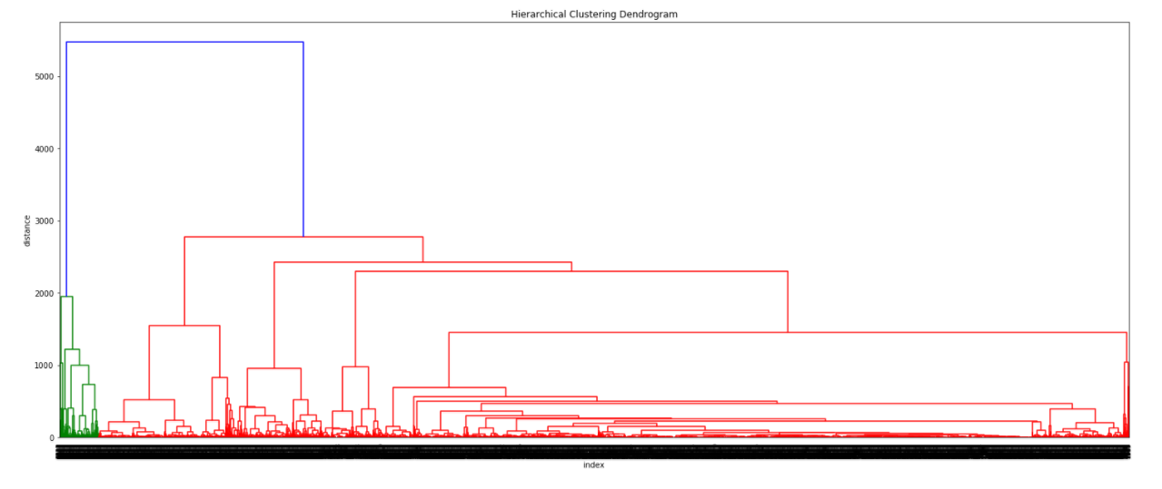
Analysis of clusters For BB-LUDHIANA-FEROZEPUR-MF(9680 customers)

Slide 10
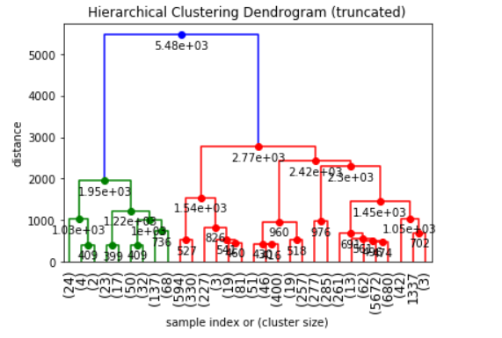
Cluster analysis
Truncated dendrogram for last 30 merges.
The first 30 clusters are already made of some customer profiles like 2, 4, 137, 594.. Customers
The number on the dots of each merge represents the distance between these two clusters.
Now if we select k=30 i.e. 30 number of clusters, then we will get the very first layer.

Slide 11
Cluster analysis
K=20 clusters
Top clusters for this store:
Gender : 0.8321
Age : 46.5
Top discount types : BBProfitClub(162), Payback(62),
Number of times promo used : 50
Top purchased products types : groceries(83), fruits & veggies(22), home needs(13), clothes(15), personal care(10), kids items(5)
Total number of customers from this Pincode : 2542
Total number of shoppings from Pincode : 121976
Number of purchases by customer : 162
Number of months customer shopped : 8
Mean number of times shopped per month : 22
Top payment modes : PCLB(11), CASH(5.5)
A cluster of family people who don’t shop too frequent but shop large when they do i.e. they buy large quantities in one go.

Slide 12
Cluster analysis
Another cluster:
Gender : 1
Age : 31
Top discount types : Payback(1385), T24Club(347)
Number of times promo used : 603
Top purchased products type : groceries(464), home needs(196), fruits & veggies(195), personal care(288), beverages(166), female sanitary needs(37), clothes(6)
Total number of customers from this Pincode : 15
Total number of shoppings from Pincode : 1953
Number of purchases by customer : 1385
Number of months customer shopped : 13
Mean number of times shopped per month : 106
Top payment modes : GVOWN(480), CASH(434), CSBK(51), EDCUBI(39)
A cluster of shopkeepers who shop almost all type of products and that too in large quantities. Stocks up his shop every other month.

Slide 13
More Ideas
Some customers also shop from multiple stores(are they on vacations?)
Gaps between shoppings(capturing shopping trends)
Some customers buy lot of Patanjali products(health concerned customers)
Body sizes from the size of clothes they buy most(L, XL?)

Slide 14
Product Recommendation
Recommend top 20 products that a customer is most likely to buy in next one month based on the given data.

Slide 15
Observations/Findings
Customers tend to buy the same products again and again
Customers tend to buy the popular products at that time
Some customers are very frequent shoppers i.e. they shop almost every month.
Some customers haven’t shopped in 2017
Some customers haven’t shopped in 2016 and 2017.

Slide 16
Heuristics rules made
A customer who has not shopped in 2016 and 2017 would most probably won’t shop in coming month, so no recommendations for such customers.
A customer who has not shopped in 2017(but has done before) is recommended 3 most popular products.
A customer who has shopped for at least 5 months in 2017 with minimum average number of products shopped per month being 35 is recommended 15 of his/her most brought products in decreasing order of number of times the product was bought.
A customer who has shopped for at least 5 months in 2017 with minimum average number of products shopped per month being 25 is recommended 10 of his/her most brought products in decreasing order of number of times the product was bought.
A customer who has shopped for at least 4 months in 2017 with minimum average number of products shopped per month being 10 is recommended 8 of his/her most brought products in decreasing order of number of times the product was bought.
For remaining of 20 places ‘None’ is used.

Slide 17
Analysis of recommendations
Lets take customer BBID_204830
Most times brought products:
Fb sis namkeen
Sofrsh trf malai 200gm
All out liq refill ultra 6*45ml
Lays onion 55gm
So most of the item this customer buys are perishable so s/he is going to buy again.
Based on heuristic rules the customer is recommended 10 most brought products.

Slide 18
More Ideas
Taking special occasions and festivals into consideration.
Socio economic class and house hold composition can be taken into consideration.
Recommend products which customers from his cluster are buying(using result of clustering problem as data)

Slide 19
Thank you

